Slide 1



Welcome! While waiting for our session to start:
Please ensure that your microphone is muted during the presentation. But we’d love if you could unmute yourself temporarily (by pressing the spacebar or CMD+A):
To giggle or laugh (we think the presenters may be funny)
To comment / ask questions
If you would like to turn on your video, great! It would be nice to see everyone. Otherwise, we respect your privacy and prerogative ☺
Issues with the Zoom? Please use Slack or the zoom chat box. Arcturus and I will check it periodically.
@mkveerapen / @hailgenetics
veerapen@broadinstitute.org
#ATGUstrong

Slide 2


Scalable Genomics for Common Variants
ATGU Welcome Workshop
July 24th, 2020
10:00 – 12:00 PM (EST)
Zoom
Kumar Veerapen, PhD
Hail Support and Community Outreach Manager
Arcturus Wang
Software Engineer
https://hail.is
@mkveerapen / @hailgenetics
veerapen@broadinstitute.org
#scalableGenomics
#hailGenetics #ATGUstrong

Slide 3
Outline
Who are we?
Who are you?
What is Hail?
Why Hail?
How can you use Hail?

Slide 4

Hail Team
Cotton Seed, PhD
Team Leader
Tim Poterba
Dan King
Jackie Goldstein
Alex Kotlar, PhD
Patrick Schultz, PhD
Whitney Wade
Operations
Kumar Veerapen, PhD
Support and Outreach
John Compitello
Arcturus Wang
Chris Vittal

Slide 5
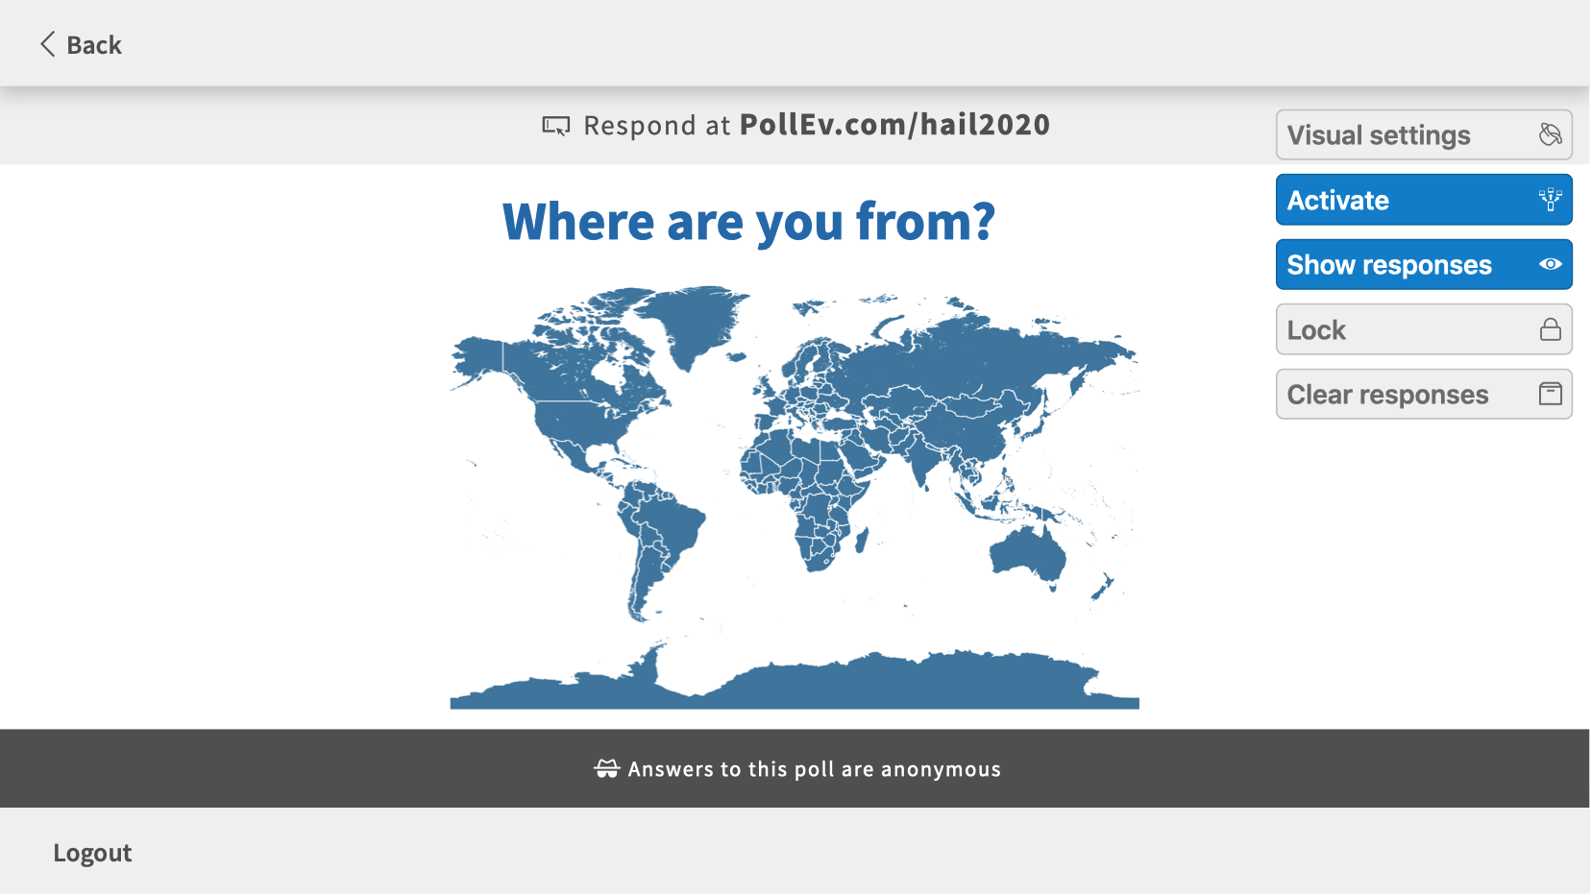

Slide 6
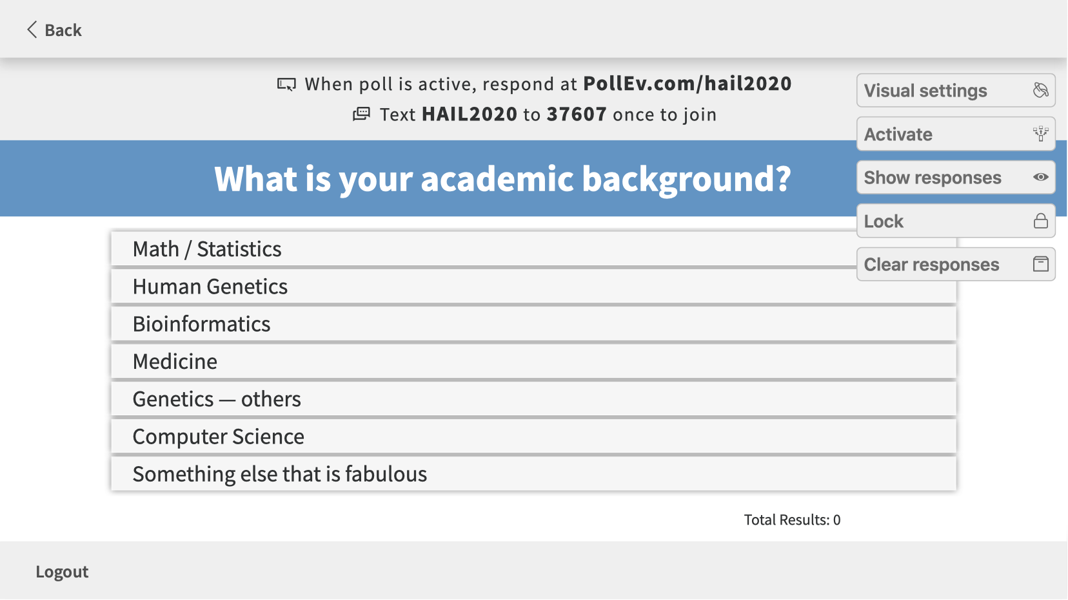

Slide 7
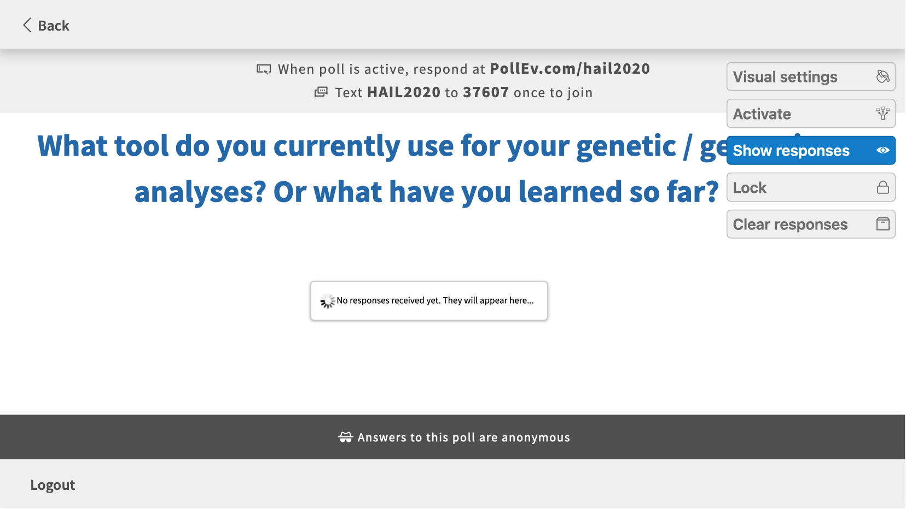

Slide 8
Accelerating Genomic Data e.g. Call Sets, variant files etc
Notes:
Zachary Stevens – Big Data Astronomical or Genomical

Slide 9
What is Hail’s role in callset generation?
.vcf file

Slide 10
What is Hail?
“On a scale from zero to dplyr, the Hail 0.2 interface scores an 8/10 for general-purpose data analysis.” - Konrad K., lead analyst, gnomAD
Open-Source Library
Genomic analysis at every scale
Learn more at Hail.is
Explore Biobank Scale Data
Interrogation of biobank scale genomic data
*We can’t read your minds, so talk to us
discuss.hail.is
Modern Data Scaling
Efficient genomic data frame scalability using Hail MatrixTables.
Unified Input Platform
Tabular data frames imported as Hail MatrixTables into unified platform.
Notes:
More dplyr, pandas rather than a plink
Scalable: Can run on a laptop, or 5000 cores on the cloud, e.g. 1 million genomes
biobank scale genomic data such as the UK Biobank, TopMed, FinnGen, and Biobank Japan.
Modern data science stack is driven by data frames where modern data science tools, e.g. python:pandas and R:dplyr, for genomic data lack the data frame scalability offered by Hail. We want to bring efficient use of data frames to genomic analysis by offering the relatively effortless manipulation offered by the use of Hail MatrixTables
Hail MatrixTable is a data frame abstraction that transcends data formats. Therefore, a MatrixTable is a format that allows for unified input formats e.g. vcf, bgen, tsv, gtf, bed files. Upon creating the unified input formats, Hail is a unified analytics platform which we want our users to feel comfortable in using to empower their science.
Most of the tools you need*, together in one place
Giving you the tools you need to indulge scientific curiosity
Actively developed which means that you ask for a feature, you will get a feature, if you it’s top of our list
Efficiency is essentially how much an analysis costs. If a program is less efficient, it will cost more. If you utilize the hardware better, thus needing less hardware to get the job done, the program is more efficient.
I think loosely when people say fast, they mean the amount of time they have to wait (wall clock time), to which I answer, at what cost? So PLINK is incredibly efficient, but has limited automatic scalability (e.g. can sometimes use multiple threads, must run on one machine). Hail, on the other hand, has good, automatic scalability but isn't very efficient (much to our collective frustrations).
We’ve built a general purpose multi-dimensional (2-d) distributed DataFrame (MatrixTable)
Growing support for distributed linear algebra
Growing suite of methods for statgen
Open-source big-data tools: Scala, Spark, Hadoop, Parquet, Kudu, Solr, Cassandra, …

Slide 11
How has Hail been used? (hail.is/references.html)
Notes:
51 abstracts (07/20/2020)
Word appearing > 4x

Slide 12
Where has Hail been used?
~28% is from Boston, MA
Notes:
First author location, and when differing with last author, the location was taken too.

Slide 13
Where in the world has Hail been “pip”-ed a.k.a. downloaded?
Adjusted for total population
Notes:
First author location, and when differing with last author, the location was taken too.

Slide 14
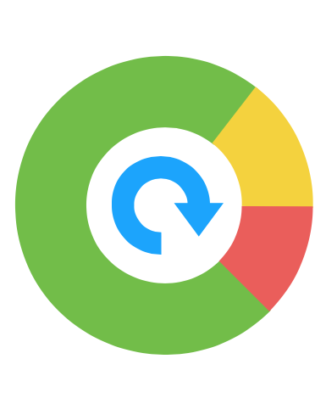
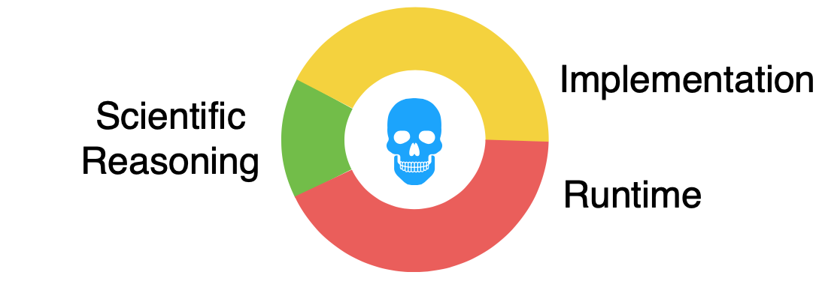
Why would you use Hail?

Slide 15
Hail as a data science library
Data slinging
Analytical toolbox

Slide 16
Hail as a data science library
Data slinging
Analytical toolbox
Read and write common formats
Filter, group, aggregate
Annotation
Visualization
VCF
TSV
BGEN
PLINK
JSON
GEN
BED
GTF

Slide 17
Hail as a data science library
Data slinging
Analytical toolbox
Read and write common formats
Filter, group, aggregate
Annotation
Visualization
Compute mean depth per variant or per sample
Among heterozygotes
Grouped by ancestry labels & sex
Count transitions & transversions called per sample

Slide 18
Hail as a data science library
Data slinging
Analytical toolbox
Read and write common formats
Filter, group, aggregate
Annotation
Visualization
Built-in wrappers for VEP, Nirvana
Join with annotations by variant, locus, interval, gene
ReferenceGenome is a first-class concept, for all our sanity
Annotation database

Slide 19
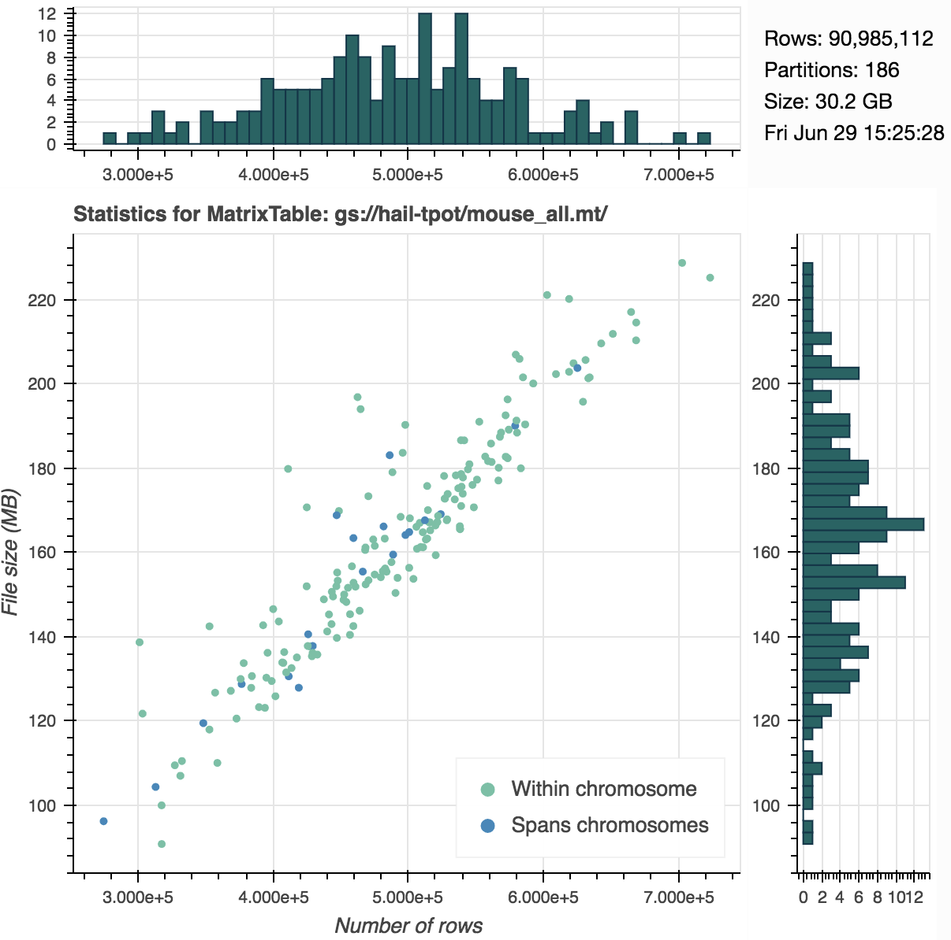
Hail as a data science library
Data slinging
Analytical toolbox
Read and write common formats
Filter, group, aggregate
Annotation
Visualization

Slide 20
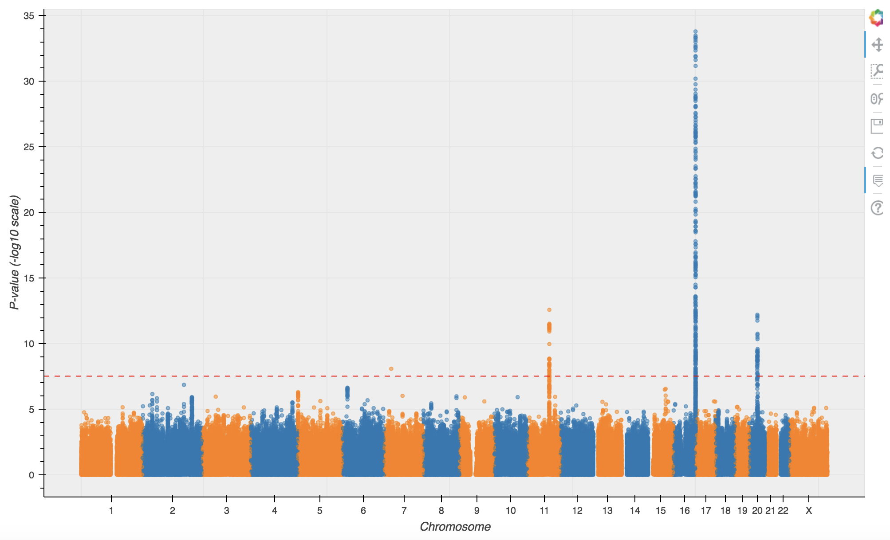
Hail as a data science library
Data slinging
Analytical toolbox
Statistical methods for genetics
Linear algebra
Linear regression
UK Biobank Rapid GWAS
Malignant melanoma
UKBB Rapid GWAS association

Slide 21
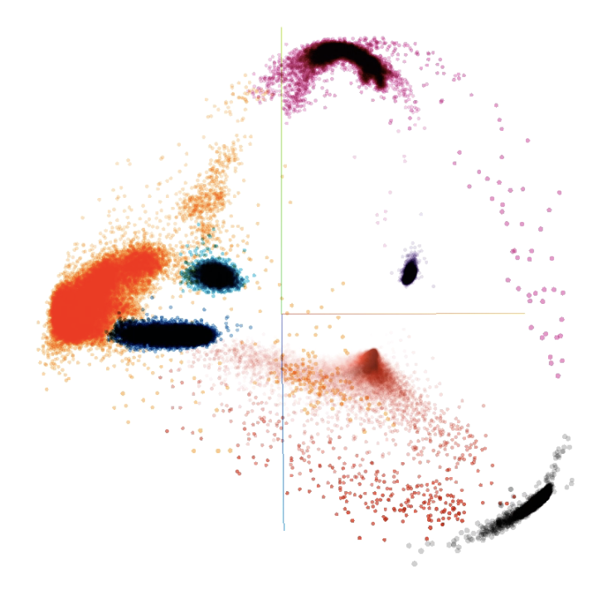
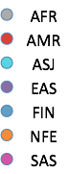
Hail as a data science library
Data slinging
Analytical toolbox
Statistical methods for genetics
Linear algebra
Genotype PCA
gnomAD

Slide 22
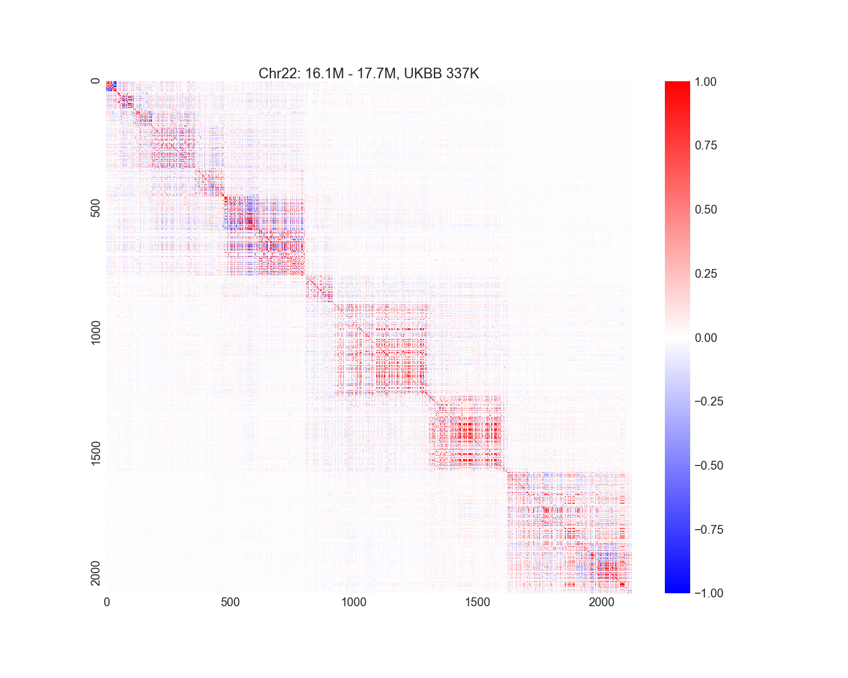
Hail as a data science library
Data slinging
Analytical toolbox
Statistical methods for genetics
Linear algebra (early stages)
Linkage disequilibrium
UK Biobank

Slide 23
Variant Call Format (VCF)
sample
ID
NA12878
…
…
…
genotypes
variant
GT | AD | DP | …
0/1 | 8,11 | 19 | …
…
CHROM | POS | RSID | REF | …
17 | 37282 | rs12345 | A | …

Slide 24
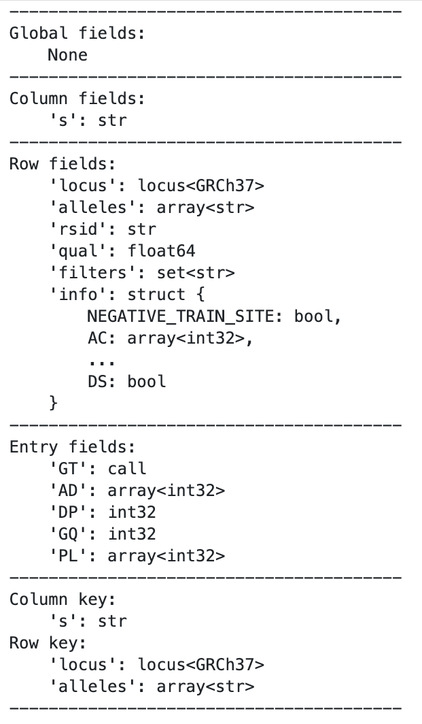
MatrixTable
cols
…
…
rows
…
entries
…
Can be extended to rare variant aggregation, trio, transcript expression
Notes:
a corresponding rows table that stores all of the row fields that are constant for every column in the dataset
a corresponding columns table that stores all of the column fields that are constant for every row in the dataset
a two-dimensional matrix of entry fields where each entry is indexed by row key(s) and column key(s)
index by row and column. Each entry is a struct of potentially many fields
a set of global fields that are constant for every entry in the dataset
Global fields represent information constant across all entries.
mt.aggregate_entries(hl.agg.mean(mt.GQ)) compute the global mean of field GQ:

Slide 25
Table MatrixTable
cols
rows
…
…
…
rows
entries
…
…
…
We have cheatsheets for this too!
https://hail.is/docs/0.2/cheatsheets.html
Notes:
Unlike a table (dataframe or SQL table), which has two field groups (row fields and global fields), a matrix table consists of four components:

Slide 26
Hands on using
workshop.hail.is
Username:
Password:

Slide 27
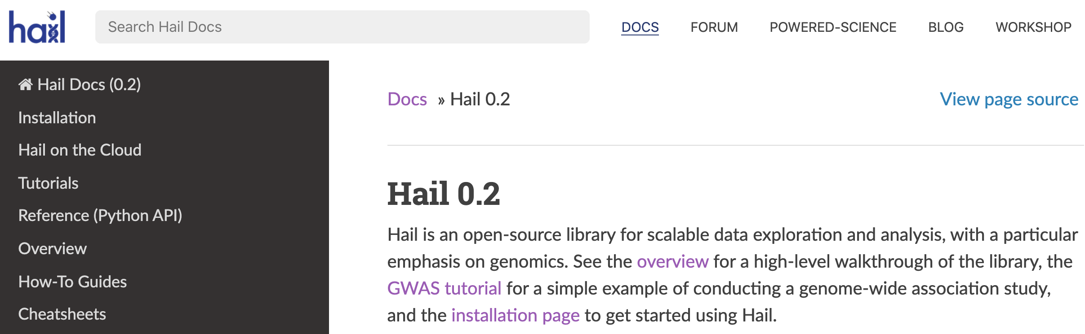
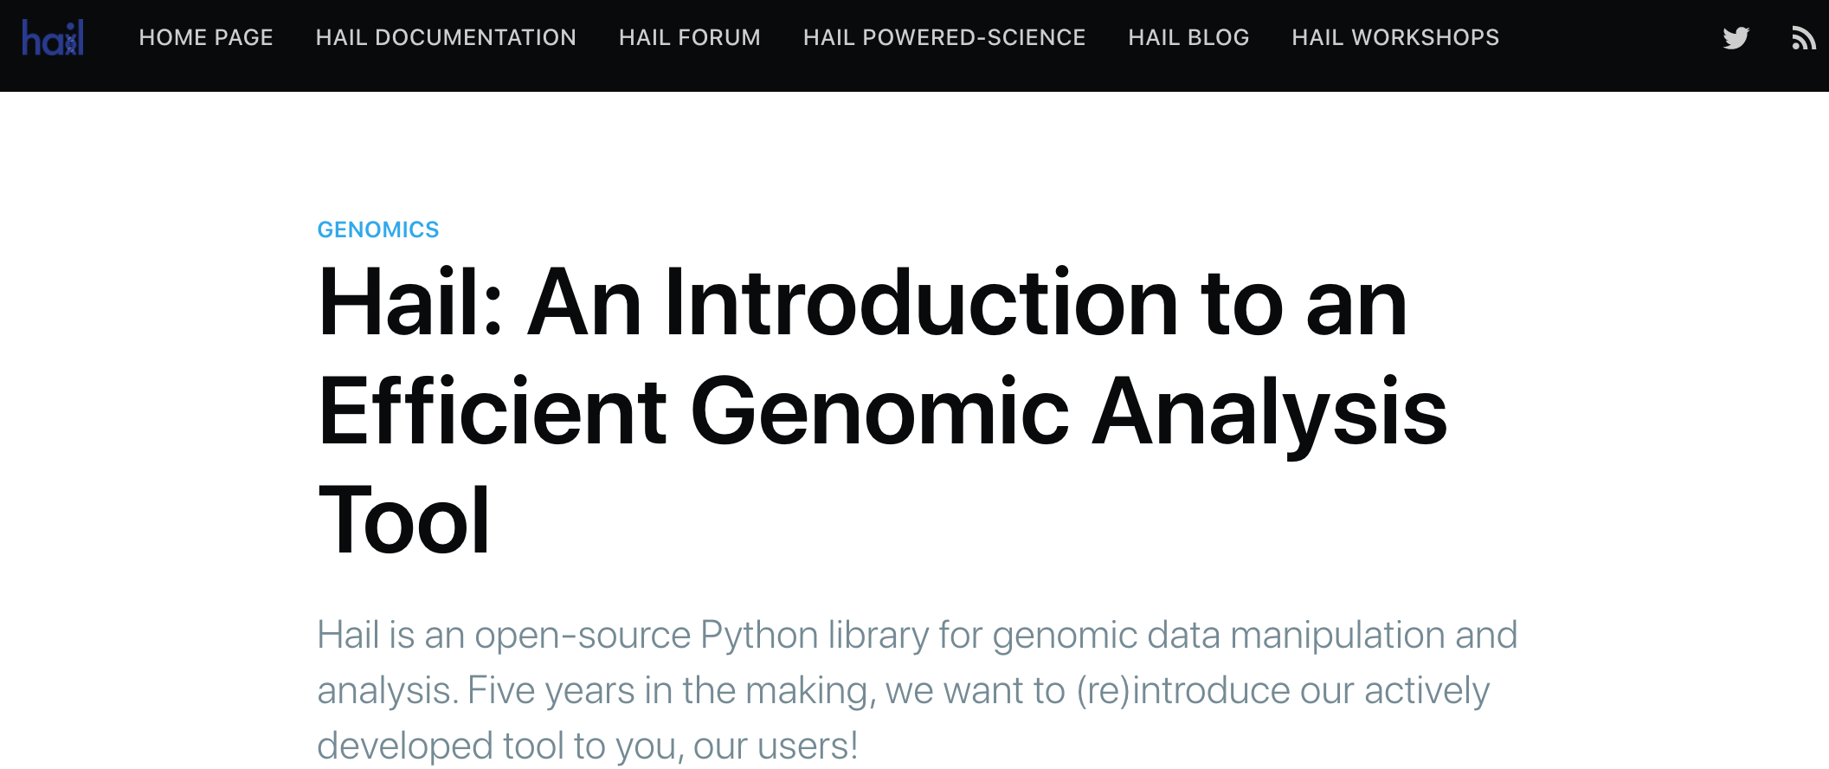

Your next steps
pip install hail
hail.is/docs/
blog.hail.is/
discuss.hail.is

Slide 28
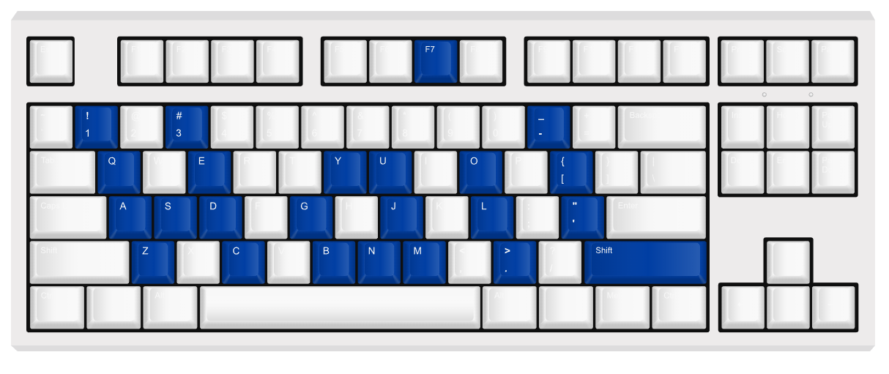
Thank you!
ATGU Welcome Workshop
Are there any questions?
Kumar Veerapen, PhD
Hail Support and Community Outreach Manager
Arcturus Wang
Software Engineer
https://hail.is
@mkveerapen / @hailgenetics
veerapen@broadinstitute.org
#scalableGenomics
#hailGenetics #ATGUstrong

